Slide 1
Lecture 2. Object Model
Object Oriented Modeling Technology
面向对象建模技术
Professor: Yushan Sun
Spring Term 2019

Slide 2
内容提要
1. 面向对象基本概念(Grady Booch book (2.2) )
2. 面向对象编程、设计、分析的基本概念
3. 对象模型元素( Grady Booch (2.3))

Slide 3
面向对象基本概念

Slide 4
1. The Foundation of the Object Model
面向对象技术建立在坚实的工程基础之上；将面向对象技术的元素的全体叫做对象模型
OO technology is built on a sound engineering foundation, whose elements we collectively call the object model.
面向对象开发建立在之前编程(尤其是结构化编程)技术与思想之上。
Object-oriented development is not a radical departure from earlier approaches. Indeed, it is founded in the best ideas from prior technologies.

Slide 5
因此，对象模型中包含了结构化设计的一些原则
The object model encompasses the principles of
  abstraction, （抽象）
  encapsulation, （封装）
  modularity, （模块化）
  hierarchy, （层次）
  typing, （类型）
  concurrency, and （并发）
  Persistence （持久）
对象模型的重要方面是 综合考虑 以上要素
What is important about the object model is that these elements are brought together in a synergistic(协作的) way.
4种主
要原则
3种次要原则，是从结构化编程继承的

Slide 6
对象模型所包含的原则的简单解释。
Concept | Description
Abstraction | 抽象出对象的外部行为
Encapsulation | 具体实现对象的行为；隐藏信息
Modularity | 将类分组放在一些包中
Hierarchy | 一群抽象（类、对象）经常形成层次；更容易理解问题
Typing | 不同类型的对象(数据)不可互换；若不强制要求类型一致，大多数程序将会在运行时神秘地垮掉。
Concurrency | 在多个CPU的机器上运行程序，需要并发；在一个CPU上运行并发程序，需要多线程
Persistence | 程序运行以后，需要永久保存的数据叫做永久数据，需要存储在数据库中

Slide 7
面向对象分析/设计与结构化设计本质上不同
OO analysis and design is fundamentally different than traditional structured design approaches:
  不同的分解方式. It requires a different way of thinking about decomposition, and
  产生非常不同的软件架构 it produces software architectures that are largely outside the realm of the structured design culture.

Slide 8
面向对象分析/设计与结构化设计不同之处：
结构化设计：使用算法(封装为函数)作为其基本的建筑模块
Structured design methods evolved to guide developers who were trying to build complex systems using algorithms as their fundamental building blocks.
面向对象设计方法：使用类与对象作为基本的建筑模块
Similarly, OO design methods have evolved to help developers exploit the expressive power of OO programming languages, using the class and object as basic building blocks.

Slide 9

对象的概念是面向对象的核心；
The concept of an object is central to anything object-oriented.
对象的非正式定义：对象是“可触知的”，并且带有行为的实体；
We can informally defined an object as a tangible entity that exhibits some well-defined behavior.
行为：bounce

Slide 10
Stefik定义对象为结合过程性质与数据的实体
Stefik defines objects as entities that combine
  the properties of procedures and 过程性质
  data 数据
since they perform computations and save local state.
Data: diameter, material,
bounce coefficient
Property of procedures： bounce

Slide 11
基本概念：对象将算法抽象与数据抽象统一起来
The basic concept here is that objects serve to unify the ideas of
  algorithmic abstraction，and (算法抽象)
  data abstraction (数据抽象)
Employee
name: String
sex: String
age: int
id: String
degree: String
position: String
数据抽象
work(): void
study(): void
attendMeeting(): void
算法抽象
Home

Slide 12
面向对象编程、设计、分析
的基本概念

Slide 13
Object-Oriented Programming (面向对象编程)
面向对象编程定义：面向对象编程为一个实现方法；利用该方法程序被组织成彼此合作的对象的集合
OO programming is a method of implementation in which programs are organized as cooperative collections of objects,
  each of which represents an instance of some class, and (每个对象代表某个类的实例)
  whose classes are all members of a hierarchy of classes(对象的类形具有层次状)

Slide 14
Object-Oriented Programming (面向对象编程)
1) 面向对象编程将程序组织成彼此合作的对象的集合
2) 每个对象的后面都有一个生成该对象的类
:Fighter
:Monster
Class
Fighter
Class
Monster
每张钱币都是由一个模板印刷出来的；一个模板可以印刷出很多钱币，一个类可以生成很多对象。

Slide 15
Object-Oriented Programming (面向对象编程)
面向对象编程定义的三个重要方面
There are three important parts to this definition:
  使用对象而不是算法编程 OO programming uses objects, not algorithms, as its fundamental logical building blocks;
  每个对象都是某个类的实例 Each object is an instance of some class; and
  可以由继承得到类之间的关系 Classes may be related to one another via inheritance relationships

Slide 16
Object-Oriented Design (面向对象设计)
编程方法 与 设计方法 的区别：强调的不同
编程方法强调合适、有效地使用某种语言机制(例如：继承，多线程，指针)
The emphasis in programming methods is primarily on the proper and effective use of particular language mechanisms.
设计方法强调有效地给复杂问题建立结构(例如，通过继承，和聚合确定类之间的关系)
By contrast, design methods emphasize the proper and effective structuring of a complex system.

Slide 17
Object-Oriented Design (面向对象设计)
面向对象设计的定义
面向对象设计是一种设计方法，包含了面向对象分解过程与各种模型的描述记号（例如，UML记号）
Object-oriented design is a method of design encompassing
  the process of object oriented decomposition and
  a notation for depicting logical and physical as well as static and dynamic models of the system under design.

Slide 18
Object-Oriented Design (面向对象设计)
面向对象分解 与 结构化分解 的区别
The support for OO decomposition is what makes OO design quite different from structured design:
  面向对象分解产生：类、对象抽象The former uses class and object abstractions to logically structure systems, and
  结构化分解产生：算法抽象(即函数抽象)the latter uses algorithmic abstractions

Slide 19
医药成本计算程序的结构化设计-使用结构化分解
Medicine Cost Computation
medicine
name
Total unit cost
medicine
name
Total
medicine
unit cost
Validated
medicine
name
Enter medicine name
Calculate medicine
unit cost
Output
cost
Medicine name
Medicine production
unit cost
Medicine
Research
unit cost
Medicine name
结构化设计：算法抽象，
建筑模块：
函数
Get research
Cost per unit
Get production
Cost per unit
医药成本计算-结构化设计

Slide 20
医药成本计算程序的面向对象设计-使用面向对象分解
CostComputation
MedicineCost
+main(String[] arg)
#medicineName
+getUnitCost()
Input
Output
+input()
+isValidNM()
+writeToFile()
+outputToScreen()
ProductionCost
ResearchCost
+getUnitCost()
+getUnitCost()
DBAccess
+getMedicineNM()
+isValidMedicineNM()
+getCostFromDB(nm: String)
面向对象设计：类或对象抽象，其基本建筑模块：类
Medicine
Database
医药成本计算-面向对象设计

Slide 21
Object-Oriented Analysis (面向对象分析)
面向对象分析强调从面向对象的视角建立现实世界模型；从问题领域描述中的类/对象的方面观察需求
Object-oriented analysis (OOA) emphasizes the building of real-world models, using an object-oriented view of the world:
  OO analysis is a method of analysis that examines requirements from the perspective of the
    classes and objects
found in the vocabulary of the problem
domain.

Slide 22

赛马软件：根据赛马过程的描述，中得到最关键的两个对象：horse， rider
:Rider
:Horse
Rider
Horse
-name: String
-sex: String
-age: int
-weight: int
-nationality: String
-name: String
-sex: String
-age: int
-weight: int
-species: String
+ride(): void
+whip(): void
+run(): void
+jump(): void

Slide 23
Object-Oriented Analysis (面向对象分析)
面向对象分析、设计、编程之间的关系
How are OOA, OOD, and OOP related?
Basically,
  the products of OO analysis serve as the models from which we may start an OO design;
  the products of OO design can then be used as blueprints for completely implementing a system using OO programming methods.
OOA
OOD
OOP

Slide 24
Object-Oriented Analysis (面向对象分析)
结构化分析/设计与面向对象分析/设计的区别2
The difference between structured analysis/ design and object oriented analysis/design
  Structured analysis produces DFD diagram, and structured design produces Structure chart (结构化分析、设计使用不同的图)
  Both OO analysis and design produce class diagrams (面向对象分析、设计使用相同的图：类图)
Home

Slide 25
对象模型元素

Slide 26
2. Elements of the Object Model
面向对象概念框架 是 对象模型
For all things object-oriented, the conceptual framework is the object model.
面向对象概念框架包含4种重要元素
There are four major elements of this model:
    Abstraction 抽象
    Encapsulation 封装
    Modularity 模块化
    Hierarchy 层次化

Slide 27
The Meaning of Abstraction (抽象的意义)
抽象是人们处理复杂性的基本方法
Abstraction is one of the fundamental ways that we as humans cope with complexity.
从观察现实世界的对象、情景、过程中关注相似点，暂时忽略不同点，以便得到抽象。
Abstraction arises from a recognition of similarities between certain objects, situations, or processes in the real world, and the decision to concentrate upon these similarities and to ignore for the time being the differences.

Slide 28
The Meaning of Abstraction (抽象的意义)
观察各种人：白人，黑人，黄种人，等等；找出共同点，忽略不同点，可以得到人对象”Person”
Person
-name: String
-sex: String
-age: float
-race: String
+eat(): void
+walk(): void
+play(): void

Slide 29


The Meaning of Abstraction (抽象的意义)
抽象的定义：抽象代表一个对象的基本特征
We define an abstraction as follows: An abstraction denotes the essential characteristics of an object that
区别此对象与其它对 distinguish it from all other kinds of objects and thus；
提供清晰的概念边界 provide crisply defined conceptual boundaries, relative to the perspective of the viewer.

Slide 30
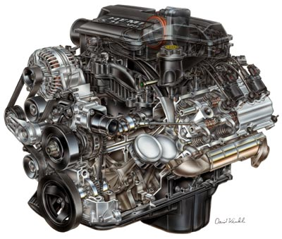
The Meaning of Abstraction (抽象的意义)
抽象关注对象的外在视图，分离对象的基本行为与其实现
An abstraction focuses on the outside view of an object and so serves to separate an object’s essential behavior from its implementation.
行为：
提供动力
抽象阶段关心外在视图
暂时不关心内在视图

Slide 31


抽象的两个原则
The Meaning of Abstraction (抽象的意义)
最低承诺原则：The principle of least commitment, through which the interface of an object provides its essential behavior, and nothing more.
最不惊讶原则：The principle of least astonishment, through which an abstraction captures the entire behavior of some object, no more and no less, and offers no surprises or side effects that go beyond the scope of the abstraction.
bark()

Slide 32
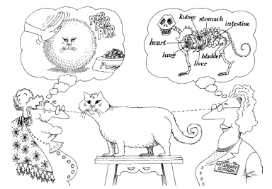
The Meaning of Abstraction (抽象的意义)
从不同的角度产生不同的抽象
Abstraction focuses on the essential characteristics of some object,
relative to the perspective of the viewer.

Slide 33
The Meaning of Abstraction (抽象的意义)
抽象的定义 迫使我们关注对象的外部视图，导引我们考虑编程的合同模型
This view forces us to concentrate on the outside view of an object and leads us to the contract model of programming:
  对象的外部视图定义了其它对象依赖的合同(Rider➔Horse)
  the outside view of each object defines a contract on which other objects may depend, and
  该合同由对象的内部视图实现
  which in turn must be carried out by the inside view of the object itself

Slide 34

The Meaning of Abstraction (抽象的意义)
合同包含了对象的责任(行为)；
This contract includes the responsibilities of an object, namely, the behavior for which it is held accountable.
合同中的操作的标识：参数、返回值等等
Each operation that contributes to this contract has a unique signature comprising all of its
  formal arguments and
  return type.
run(int speed): void
bomb(int x, int y): boolean
getWeaponType(): Weapon

Slide 35
The Meaning of Abstraction (抽象的意义)
协议：客户可以使用的全体操作以及调用顺序叫做协议；
We call the entire set of operations that a client may perform on an object, together with the legal orderings in which they may be invoked, its protocol.

Slide 36

Examples of Abstraction
水培农场的例子
问题描述：
植物用营养液培植（无土）
需要维护大棚环境（与种植的作物品种有关）
自动 控制温度、湿度、光照、酸碱度、营养成分；
根据种植计划，调整温度、湿度、光照等
需要：空气、水、湿度、光照、酸碱度与营养浓度传感器，实施监测

Slide 37
Examples of Abstraction
重要性质 (Important characteristics)
需要温度传感器测量某地点的温度
Need a temperature sensor to measure the
  Temperature （温度）at specific
  location (测量地点)
每个温度传感器都有地点与唯一标识
A temperature sensor can be thought as an object with a location and unique identity

Slide 38
Examples of Abstraction
温度（湿度）传感器的责任
  a sensor is responsible for knowing the temperature (humidity) at a given location and reporting that temperature when asked.
TemperatureSensor
HumiditySensor
-identity: String
-location: String
-temperature: float
-identity: String
-location: String
-humidity: float
+report(): float
+report(): float
Fig 2-6 Abstraction of Sensors

Slide 39
Examples of Abstraction
种植计划(Growing Plan)抽象：对每种作物，描述所需的温度、光照、营养、等，以便获得最好的收成。
每种作物拥有其自己的生长计划，但是所有的种植计划都有相同的格式
种植计划的其它责任：跟踪与种植一种作物相关的所有的行动
客户程序创建计划的细节，修改计划，请求计划

Slide 40
Examples of Abstraction
GrowingPlan
-name: String
-temperature: String
-light: float
-nutrients: float[ ]
例如：tomato growing plan
+establishPlan(): void
+modifyPlan(): void
+clearPlan(): void
Fig 2-8 Abstraction of a Growing Plan

Slide 41
The Meaning of Encapsulation
先进行抽象，然后再考虑实现（实现细节被隐藏）
The abstraction of an object should precede the decisions about its implementation.
  Once an implementation is selected, it should be treated as a secret of the abstraction and hidden from most clients.

Slide 42
The Meaning of Encapsulation
抽象与封装是互补的概念
Abstraction and encapsulation are complementary concepts:
  Abstraction focuses on the observable behavior of an object 抽象关注对象外部可见行为
  encapsulation focuses on the implementation that gives rise to this behavior 封装关注行为的具体实现

Slide 43
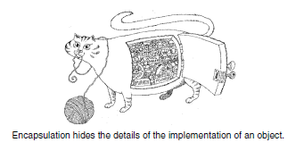
The Meaning of Encapsulation
机器人猫
抽象：描述猫的外部行为：eat(), jump(),
climbTree()
封装：关注行为的具体实现，即关心怎样实现eat(), jump(), climbTree()行为，并将实现细节隐藏起来

Slide 44
The Meaning of Encapsulation
通过信息隐藏进行封装。隐藏对象结构、方法的实现细节
Encapsulation is most often achieved through information hiding, which is the process of hiding all the secrets of an object that do not contribute to its essential characteristics; typically,
  the structure of an object is hidden, as well as
  the implementation of its methods.

Slide 45
例如：
TemperatureSensor
-identity: String
-location: String
-temperature: float
+report(): float
属性部分identity, location, temperature被隐藏了，防止其它对象对其非法直接访问或者非法修改。
方法report()的实现代码被隐藏了，防止其它的方法对其内部代码进行直接调用。

Slide 46
The Meaning of Encapsulation
抽象帮助人们清楚他们要做什么
Whereas abstraction“helps people to think about what they are doing,”
封装使得程序改变比较容易与可靠
encapsulation “allows program changes to be reliably made with limited effort” .
封装提供不同抽象之间的屏障，保证了责任分离
Encapsulation provides explicit barriers among different abstractions and thus leads to a clear separation of concerns.

Slide 47
The Meaning of Encapsulation
为了使抽象可行，实现必须被封装。
For abstraction to work, implementations must be encapsulated.
每个类都有两部分，接口部分 与 实现部分
This means that each class must have two parts:
  an interface and 接口
  an implementation 实现

Slide 48
Java Class String提供的接口：封装的结果
char | charAt(int index), Returns the character at the specified index.
int | compareTo(String anotherString) Compares two strings lexicographically.
String | concat(String str) Concatenates the specified string to the end of this string.
boolean | equals(Object anObject) Compares this string to the specified object.
boolean | equalsIgnoreCase(String anotherString) Compares this String to another String, ignoring case considerations.
用户程序仅仅看到了此接口，而不知道，也没有必要知道其内部实现细节。
接口提供了合同。客户类只要按照此方法提供的参数类型调用，即可得到接口所声明的结果。

Slide 49
The Meaning of Encapsulation
接口捕捉了外部视图。The interface of a class captures only its outside view, encompassing our abstraction of the behavior common to all instances of the class.
实现部分包含抽象的机制以及取得期望行为的机制。The implementation of a class comprises the representation of the abstraction as well as the mechanisms that achieve the desired behavior.

Slide 50
The Meaning of Encapsulation
封装的定义：将抽象中的(组成结构与行为的)元素划分为独立的部分的过程；封装强调分离概念接口及其实现
To summarize, we define encapsulation as follows:
  Encapsulation is the process of compartmentalizing the elements of an abstraction that constitute its structure and behavior;
  encapsulation serves to separate the contractual interface of an abstraction and its implementation.

Slide 51
Example of Encapsulation
To illustrate the principle of encapsulation, let’s take an example of hydroponics farm problem again.
TemperatureSensor
HumiditySensor
-identity: String
-location: String
-temperature: float
-identity: String
-location: String
-humidity: float
+report(): float
+report(): float

Slide 52
GrowingPlan
-name: String
-temperature: String
-light: float
-nutrients: float[ ]
+establishPlan(): void
+modifyPlan(): void
+clearPlan(): void
All the attributes in classes TemperatureSensor, HumiditySensor and GrowingPlan are encapsulated (hidden)
All the implementation details for all the methods in the above classes are encapsulated (hidden)

Slide 53
Class TemperatureSensor
Constructor
 | TemperatureSensor(): create a TemperatureSensor object
Methods
float | report(): report current temperature
Class HumiditySensor
Constructor
 | HumiditySensor(): create a HumiditySensor object
Methods
float | report(): report current humidity

Slide 54
Class GrowingPlan
Constructor
 | GrowingPlan(): create a GrowingPlan object
Methods
float | establishPlan(): user creates a growing plan for a specific plant
void | modifyPlan(): user calls this method to modify a plan
void | clearPlan(): user calls this method to cancel a plan

Slide 55
The Meaning of Modularity
Smalltalk没有module概念; Java提供了package
In some languages, such as Smalltalk, there is no concept of a module, so the class forms the only physical unit of decomposition. Java has packages that contain classes.
在C++, 与 Ada中，模块是独立的语言结构
In many other languages, including , C++, and Ada, the module is a separate language construct and therefore warrants a separate set of design decisions.

Slide 56
The Meaning of Modularity
类和对象形成了系统逻辑结构，可以将它们打包
In these languages, classes and objects form the logical structure of a system; we place these abstractions in modules to produce the system’s physical architecture.
尤其是在大的复杂系统中，可能包含上千的类，因此有必要使用module帮助管理复杂度
Especially for larger applications, in which we may have many hundreds of classes, the use of modules is essential to help manage complexity.

Slide 57
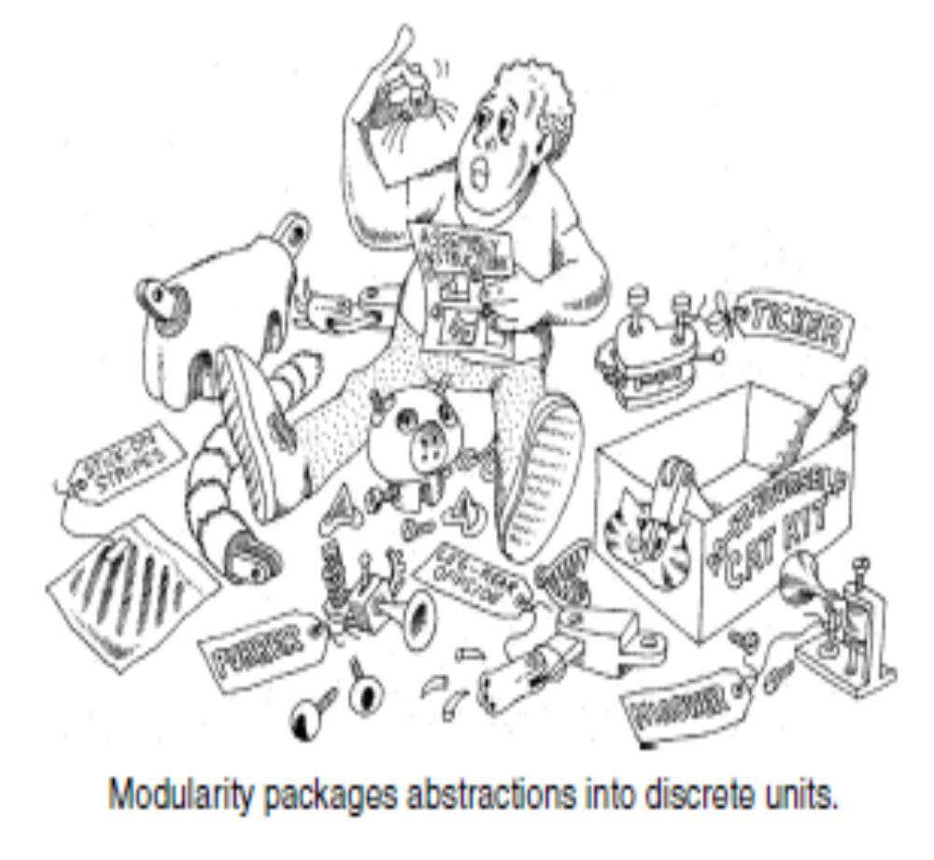
The Meaning of Modularity
模块化将抽象包装成不同的离散单元

Slide 58
The Meaning of Modularity
模块化将抽象包装成不同的离散的单元

Slide 59
The Meaning of Modularity
模块化包含将程序划分为可以单独编译的模块；模块之间可以相互链接（代表包之间的接口）
Modularization consists of dividing a program into modules which can be compiled separately, but which have connections with other modules.
The connections between modules are the assumptions which the modules make about each other.

Slide 60
The Meaning of Modularity
支持模块化的语言也支持区别模块接口、模块实现
Most languages that support the module as a separate concept also distinguish between
  the interface of a module and
  its implementation.

Slide 61
The Meaning of Modularity
接口
methods
Class 1
Class 4
Class 7
Class 2
Class 5
Class 8
Class 3
Class 6
Class 9

Slide 62






The Meaning of Modularity
传统的结构化设计中的模块化，依据耦合与内聚原则，将子程序分组。In traditional structured design, modularization is primarily concerned with the meaningful grouping of subprograms, using the criteria of coupling and cohesion.
module1
module2
module3

Slide 63














The Meaning of Modularity
面向对象设计中的模块化，将类分组放在一些包中。In OO design, the problem is subtly different: The task is to decide where to physically package the classes and objects, which are distinctly different from subprograms.

Slide 64
The Meaning of Modularity
抽象、封装、模块化之间的协作关系：
Thus, the principles of abstraction, encapsulation, and modularity are synergistic (协作)
  An object provides a crisp boundary around a single abstraction 抽象提供了边界
  and both encapsulation and modularity provide barriers around this abstraction. 封装与模块化给该抽象提供了屏障

Slide 65
The Meaning of Hierarchy
一群抽象经常形成层次；更容易理解问题
A set of abstractions often forms a hierarchy, and by identifying these hierarchies in our design, we greatly simplify our understanding of the problem.
层次的定义
We define hierarchy as follows: Hierarchy is a ranking or ordering of abstractions.
The two most important hierarchies :
  “is a” hierarchy， and
  “part of” hierarchy.

Slide 66
Examples of Hierarchy: Single Inheritance
可以利用继承构造层次结构，继承是面向对象的基本要素
Inheritance is the most important “is a” hierarchy, and as we noted earlier, it is an essential element of OO systems.
继承代表一种类型的层次抽象：子类继承超类的功能，子类通常扩展、重新定义了超类的结构与行为
Inheritance thus represents a hierarchy of abstractions, in which a subclass inherits from one or more super classes.
  Typically, a subclass augments or redefines the existing structure and behavior of its super classes.

Slide 67
Examples of Hierarchy: Single Inheritance
多边形
三角形
四边形
等腰
三角形
平行
四边形
直角
三角形
矩形
Abstractions form a hierarchy

Slide 68
Examples of Hierarchy: Single Inheritance
继承代表了“is a” 关系
Semantically, inheritance denotes an “is a” relationship. For example,
  a bear “is a” kind of mammal,
  a house “is a” kind of tangible asset
继承暗示generalization/specialization层次结构
Inheritance implies a generalization/specialization hierarchy, wherein a subclass specializes the more general structure or behavior of its superclasses.
  If B is not a kind of A, then B should not inherit from A.

Slide 69
Examples of Hierarchy: Single Inheritance
【例】不同种类的作物，需要不同的专门的种植计划
Consider the different kinds of growing plans we may use in the Hydroponics Gardening System.

Slide 70
GrowingPlan
-name: String
-temperature: String
-light: float
-nutrients: float[ ]
+establishPlan(): void
+modifyPlan(): void
+clearPlan(): void
FruitPlan
VegetablePlan
-pollinationTime
-growthPeriod
ApplePlan
BananaPlan
TomatoPlan
PotatoPlan

Slide 71
两种类型的传感器应该有一个共同的超类：Sensor
Sensor
-identity: String
-location: String
+report(): float
TemperatureSensor
HumiditySensor
-temperature: float
-humidity: float
+report(): float
+report(): float

Slide 72
Examples of Hierarchy: Single Inheritance
当我们进化我们的继承层次，子类的共同结构和行为向其超类迁移
As we evolve our inheritance hierarchy, the
  structure and
  behavior
that are common for different classes will tend to migrate to common superclasses.

Slide 73
Examples of Hierarchy: Single Inheritance
这就是将继承视为 泛化/专门化 的原因
This is why we often speak of inheritance as being a generalization/specialization hierarchy.
  Superclasses represent generalized abstractions, and
  subclasses represent specializations in which fields and methods from the superclass are added, modified, or even hidden.

Slide 74
Examples of Hierarchy: Single Inheritance
继承可能以3种方式破坏封装：
With inheritance, encapsulation can be violated in one of three ways:
The subclass might
  access an instance variable of its superclass,子类访问超类的变量
  call a private operation of its superclass, or 调用超类的私有方法；
  refer directly to superclasses of its superclass” 引用超类的超类

Slide 75
Examples of Hierarchy: Aggregation
“part of”层次化描述了聚合关系
“part of” hierarchies describe aggregation relationships.
GreenHouse
Sensor
-identity: String
-location: String
-temperature
-humidity
-sensor: Sensor
+report(): float
+getTemperature()
+getHumidity()
+setTemperature()
+setHumidity()
TemSensor
HumidSensor
-temperature: float
-humidity: float
+report(): float
+report(): float

Slide 76
继承与聚合相结合 产生强大的力量
The combination of inheritance with aggregation is powerful:
  Aggregation permits the physical grouping of logically related structures, and
  inheritance allows these common groups to be easily reused among different abstractions.
GreenHouse
Sensor
VegeGHouse
GrainGHouse
TemSensor
HumidSensor

Slide 77
关于抽象层次
“is a” 层次结构：高层抽象宽泛、低层抽象具体
In terms of its “is a” hierarchy, a high-level abstraction is generalized, and a low-level abstraction is specialized.
“part of” 层次结构：“聚合类”比“组成类”更高层
In terms of its “part of” hierarchy, a class is at a higher level of abstraction than any of the classes that make up its implementation.

Slide 78
课堂练习
猫科动物(felid)是猫生物家族的统称。猫科动物包含两个亚科：1) 豹亚科(Pantherinae)，包括老虎(tiger)，狮子(lion)，美洲虎(jaguar)，豹子(leopard)； 2) 猫亚科(Felinae), 包括美洲狮(cougar)，非洲猎豹(cheetah)。
猫科动物的重要属性是体长（body length）和奔跑速度（speed）。在以上这些猫科动物中，美洲虎、豹子和美洲狮都会爬树(Climb tree)，其余的都不会爬树；所有的猫科动物都是纯食肉动物，因此必须狩猎（hunt）。
要求：假如项目组长要求你根据以上信息进行面向对象设计。
1）建立猫科动物层次类；
2）结合你的设计说明面向对象元素抽象的概念；
3）结合你的设计说明面向对象元素封装的概念；
4）结合你的设计说明面向对象元素层次化的概念。
Home

Slide 79
本节总结
1. 对象模型中包含了的原则
  abstraction, （抽象）
  encapsulation, （封装）
  modularity, （模块化）
  hierarchy, （层次）
  typing, （类型）
  concurrency, and （并发）
  Persistence （持久）

Slide 80
本节总结
2. 对象为结合过程性质与数据的实体
Stefik defines objects as entities that combine
  the properties of procedures and 过程性质
  data 数据
since they perform computations and save local state.

Slide 81
本节总结
3. 对象将算法抽象与数据抽象统一起来
Objects serve to unify the ideas of
  algorithmic abstraction，and (算法抽象)
  data abstraction (数据抽象)
Employee
name: String
sex: String
age: int
id: String
degree: String
position: String
数据抽象
work(): void
study(): void
attendMeeting(): void
算法抽象

Slide 82
本节总结
4. 面向对象编程定义：面向对象编程为一个实现方法；利用该方法程序被组织成彼此合作的对象的集合
面向对象编程定义的三个重要方面
  使用对象而不是算法编程;
  每个对象都是某个类的实例
  可以由继承得到类之间的关系

Slide 83
本节总结
5. 编程方法 与 设计方法 的区别：强调的不同
  编程方法强调合适、有效地使用某种语言机制(例如：继承，多线程，指针)
  设计方法强调有效地给复杂问题建立结构(例如，通过继承，和聚合确定类之间的关系)
6. 面向对象设计的定义
面向对象设计是一种设计方法，包含了面向对象
  分解过程与
  各种模型的描述记号（例如，UML记号）

Slide 84
本节总结
7. 面向对象分解 与 结构化分解 的区别
  面向对象分解产生：类、对象抽象
  结构化分解产生：算法抽象(即函数抽象)
8. 面向对象分析强调从面向对象的视角建立现实世界模型；从问题领域描述中的类/对象的方面观察需求
9. 面向对象分析、设计、编程之间的关系
OOA
OOD
OOP

Slide 85
本节总结
10. 结构化分析/设计与面向对象分析/设计的区别2
  结构化分析、设计使用不同的图
  面向对象分析、设计使用相同的图：类图
11. 抽象是人们处理复杂性的基本方法；从观察现实世界的对象、情景、过程中关注相似点，暂时忽略不同点，以便得到抽象。
12. 抽象的定义：抽象代表一个对象的基本特征
  区别此对象与其它对象
  提供清晰的概念边界
  抽象关注对象的外在视图，分离对象的基本行为与其实现

Slide 86
13. 抽象的两个原则
本节总结
最低承诺原则：对象的接口仅仅提供基本行为，而不是更多
最不惊讶原则：抽象捕捉了某对象的全部行为，不多不少。没有超越边界的“惊喜”和副作用
14. 抽象的定义 迫使我们关注对象的外部视图，导引我们考虑编程的合同模型；对象的外部视图定义了其它对象依赖的合同
合同包含了对象的责任(行为)；
合同中的操作的标识：参数、返回值等等

Slide 87
本节总结
15. 通过信息隐藏进行封装。隐藏对象结构、方法
的实现细节
16. 抽象与封装是互补的概念
  抽象关注对象外部可见行为
  封装关注行为的具体实现
抽象帮助人们清楚他们要做什么
封装使得程序改变比较容易与可靠.
封装提供不同抽象之间的屏障，保证了责任分离

Slide 88
本节总结
17. 封装的定义：将抽象中的(组成结构与行为的)元素划分为独立的部分的过程；封装强调分离概念接口及其实现。
通过信息隐藏进行封装。隐藏对象结构、方法的实现细节
18. 模块化
  模块化包含将程序划分为可以单独编译的模块；模块之间可以相互链接（代表包之间的接口）
  面向对象设计中的模块化，将类分组放在一些包中。

Slide 89
本节总结
19. 抽象、封装、模块化之间的协作关系：
  抽象提供了边界
  封装与模块化给该抽象提供了屏障
20. 面向对象的两种层次结构：
  “is a” hierarchy， and
  “part of” hierarchy.

